Slide 1

Introduction
Slide Deck

Slide 2
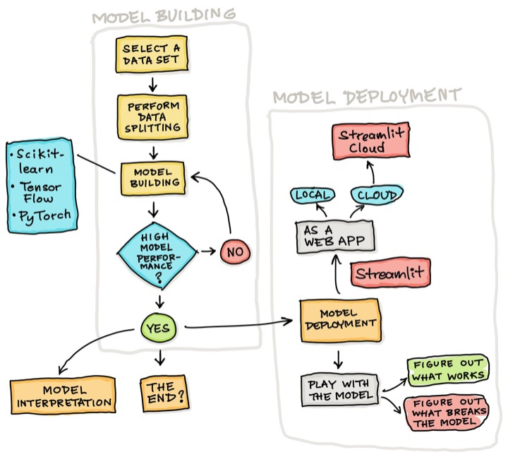
Deploying ML models
Model deployment is the endpoint of a data science workflow.
Models can be deployed as:
Jupyter notebooks
API
Web apps

Slide 3
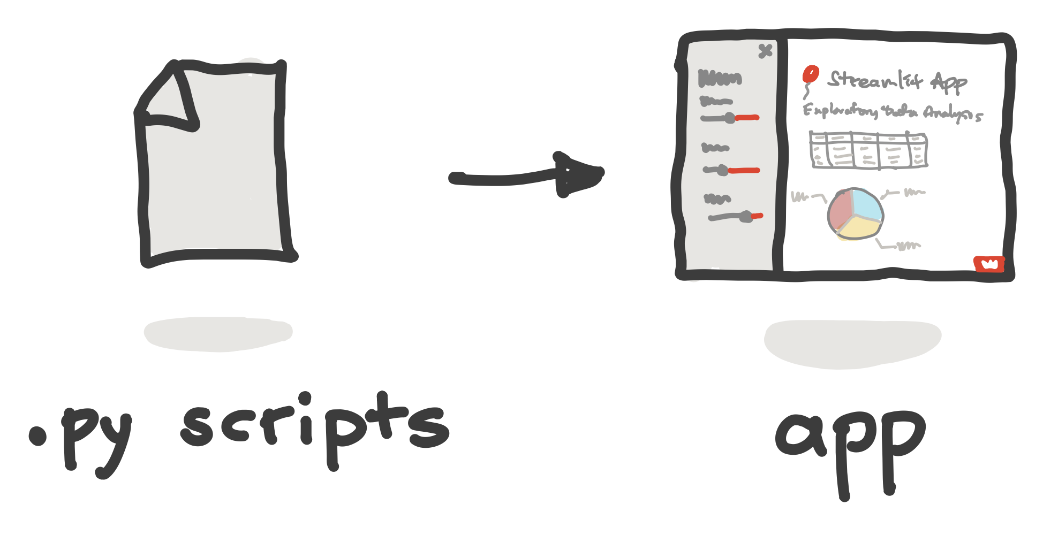
It’s fast and easy to build web apps
To build a web app you’d typically use such Python web frameworks as Django and Flask
But the steep learning curve and the big time investment for implementing these apps present a major hurdle
Streamlit makes the app creation process as simple as writing Python scripts

Slide 4
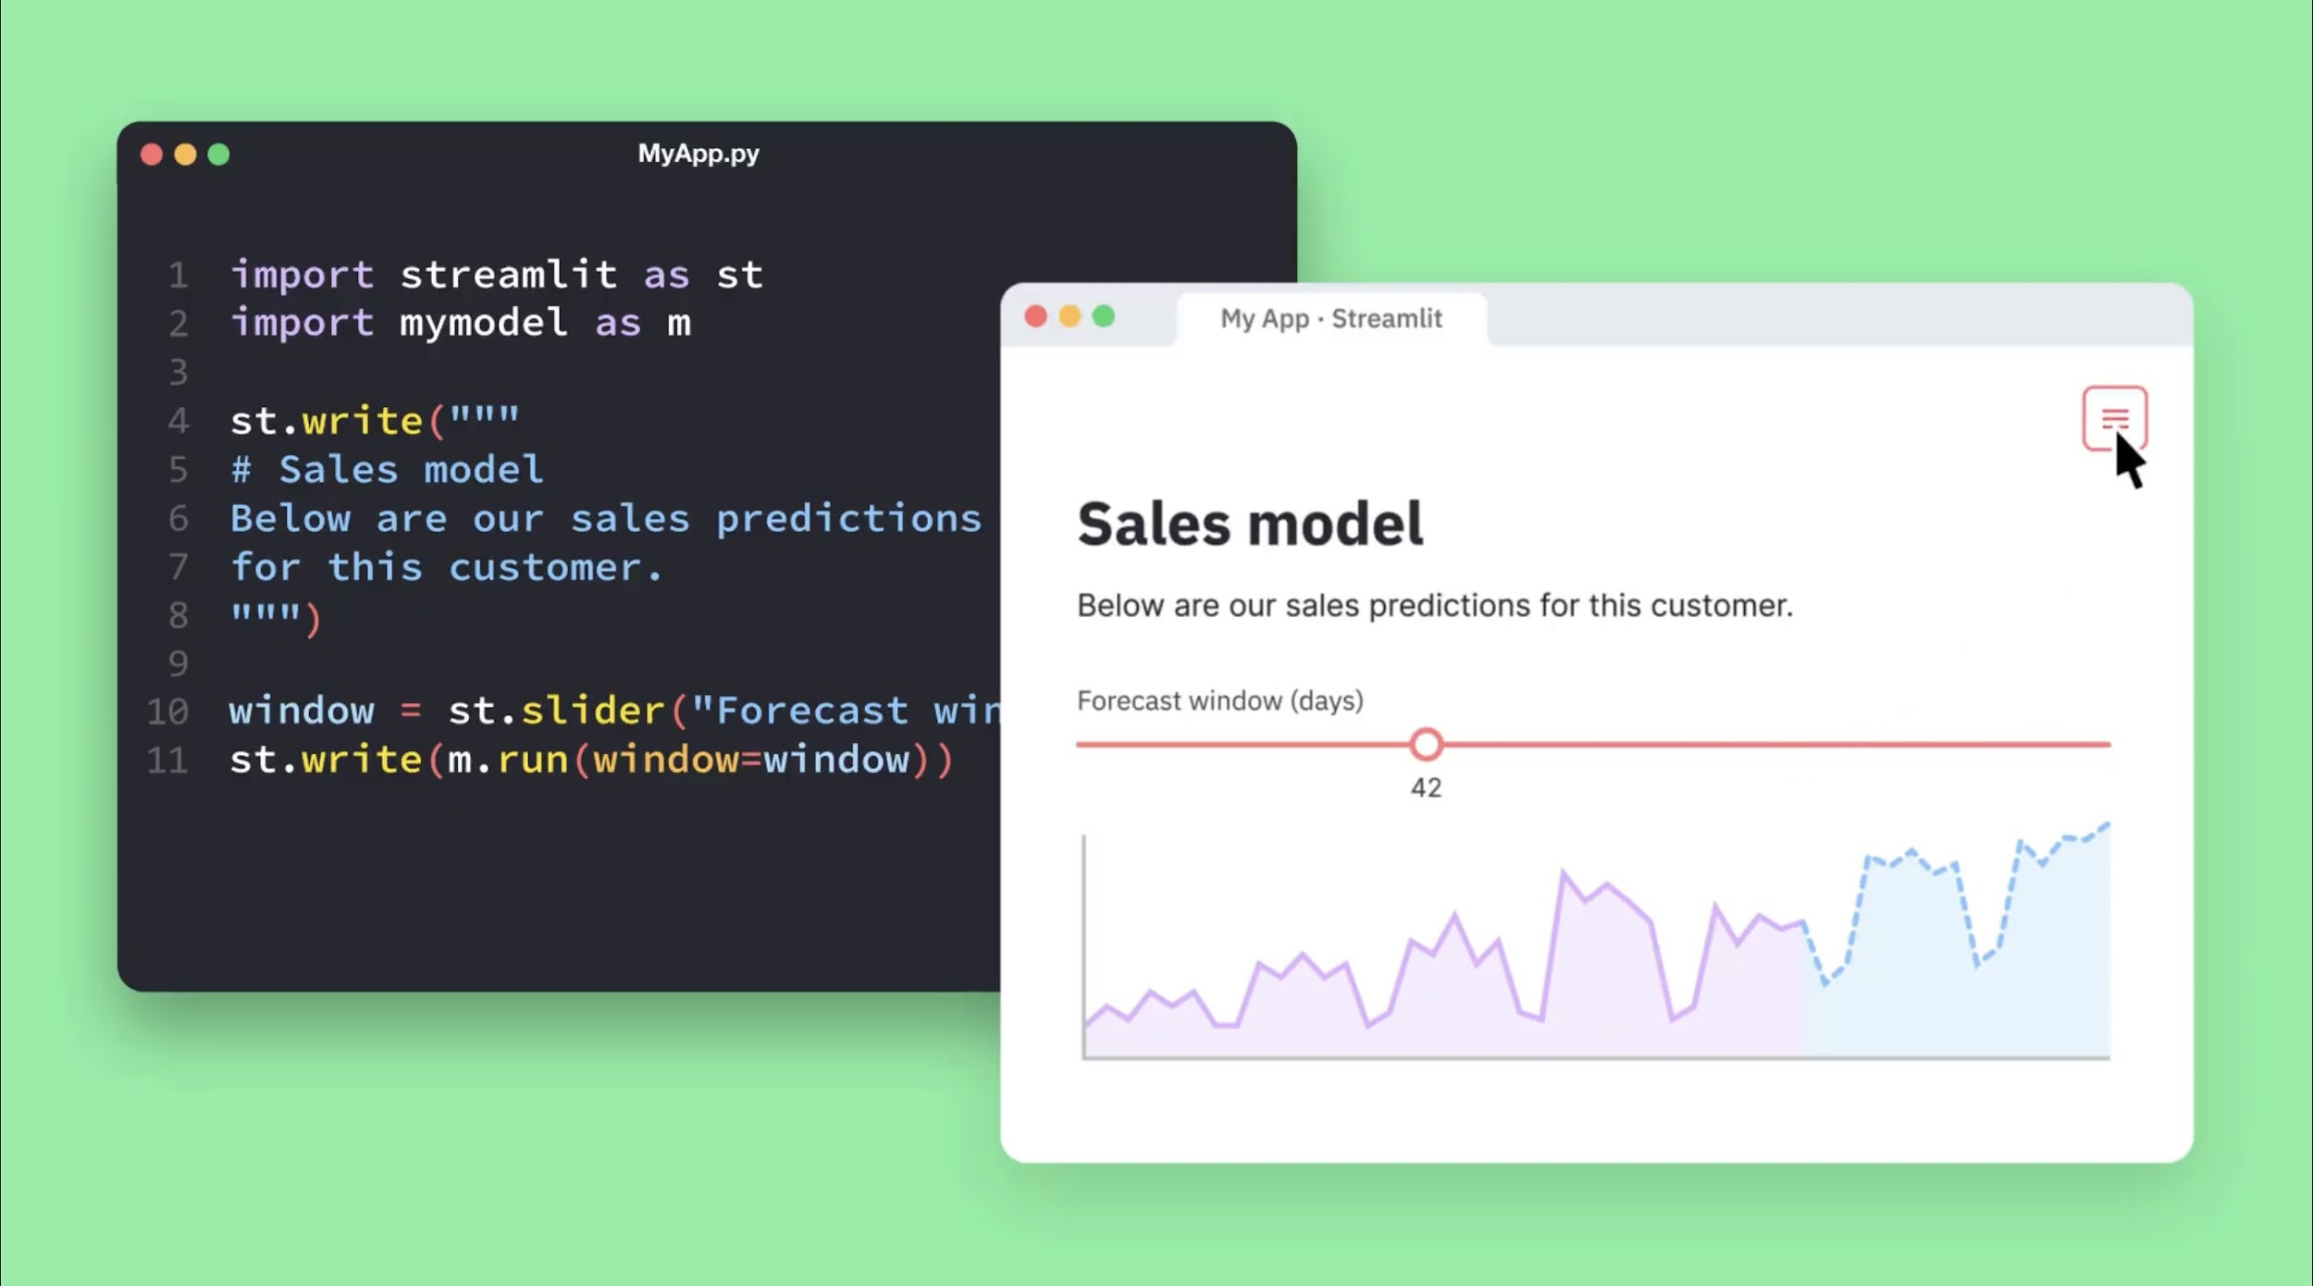
Enter Streamlit …
Streamlit is an open source web framework in Python that turns data scripts into shareable web apps in minutes
Typically, creating web apps require a steep learning curve
Streamlit requires no front-end experience (as this is already handled by Streamlit) so you can focus on the data and model

Slide 5

Prerequisites
Have basic Python knowledge.
Write scripts to perform specific tasks
Taking several Excel files as input and combining them into one
Build and grow the Streamlit app line by line instead of starting with a predefined layout (it takes only a few lines of code)

Slide 6

Installing Streamlit
Streamlit can be installed via pip:
pip install streamlit
streamlit hello
Streamlit can be installed via conda:
conda install -c conda-forge streamlit

Slide 7
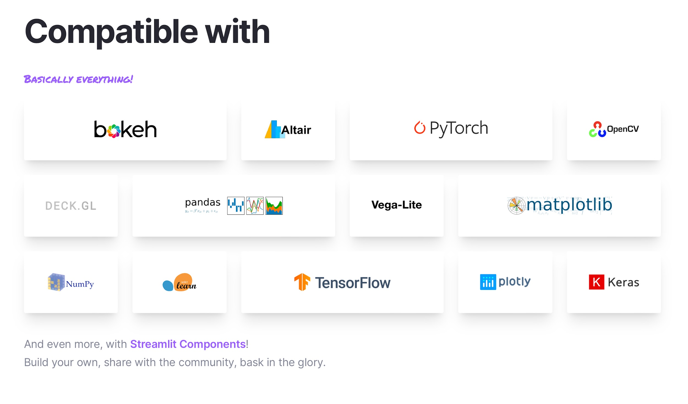
Python data ecosystem
The Python data ecosystem is comprised of several complementary Python libraries that facilitate the data science workflow

Slide 8
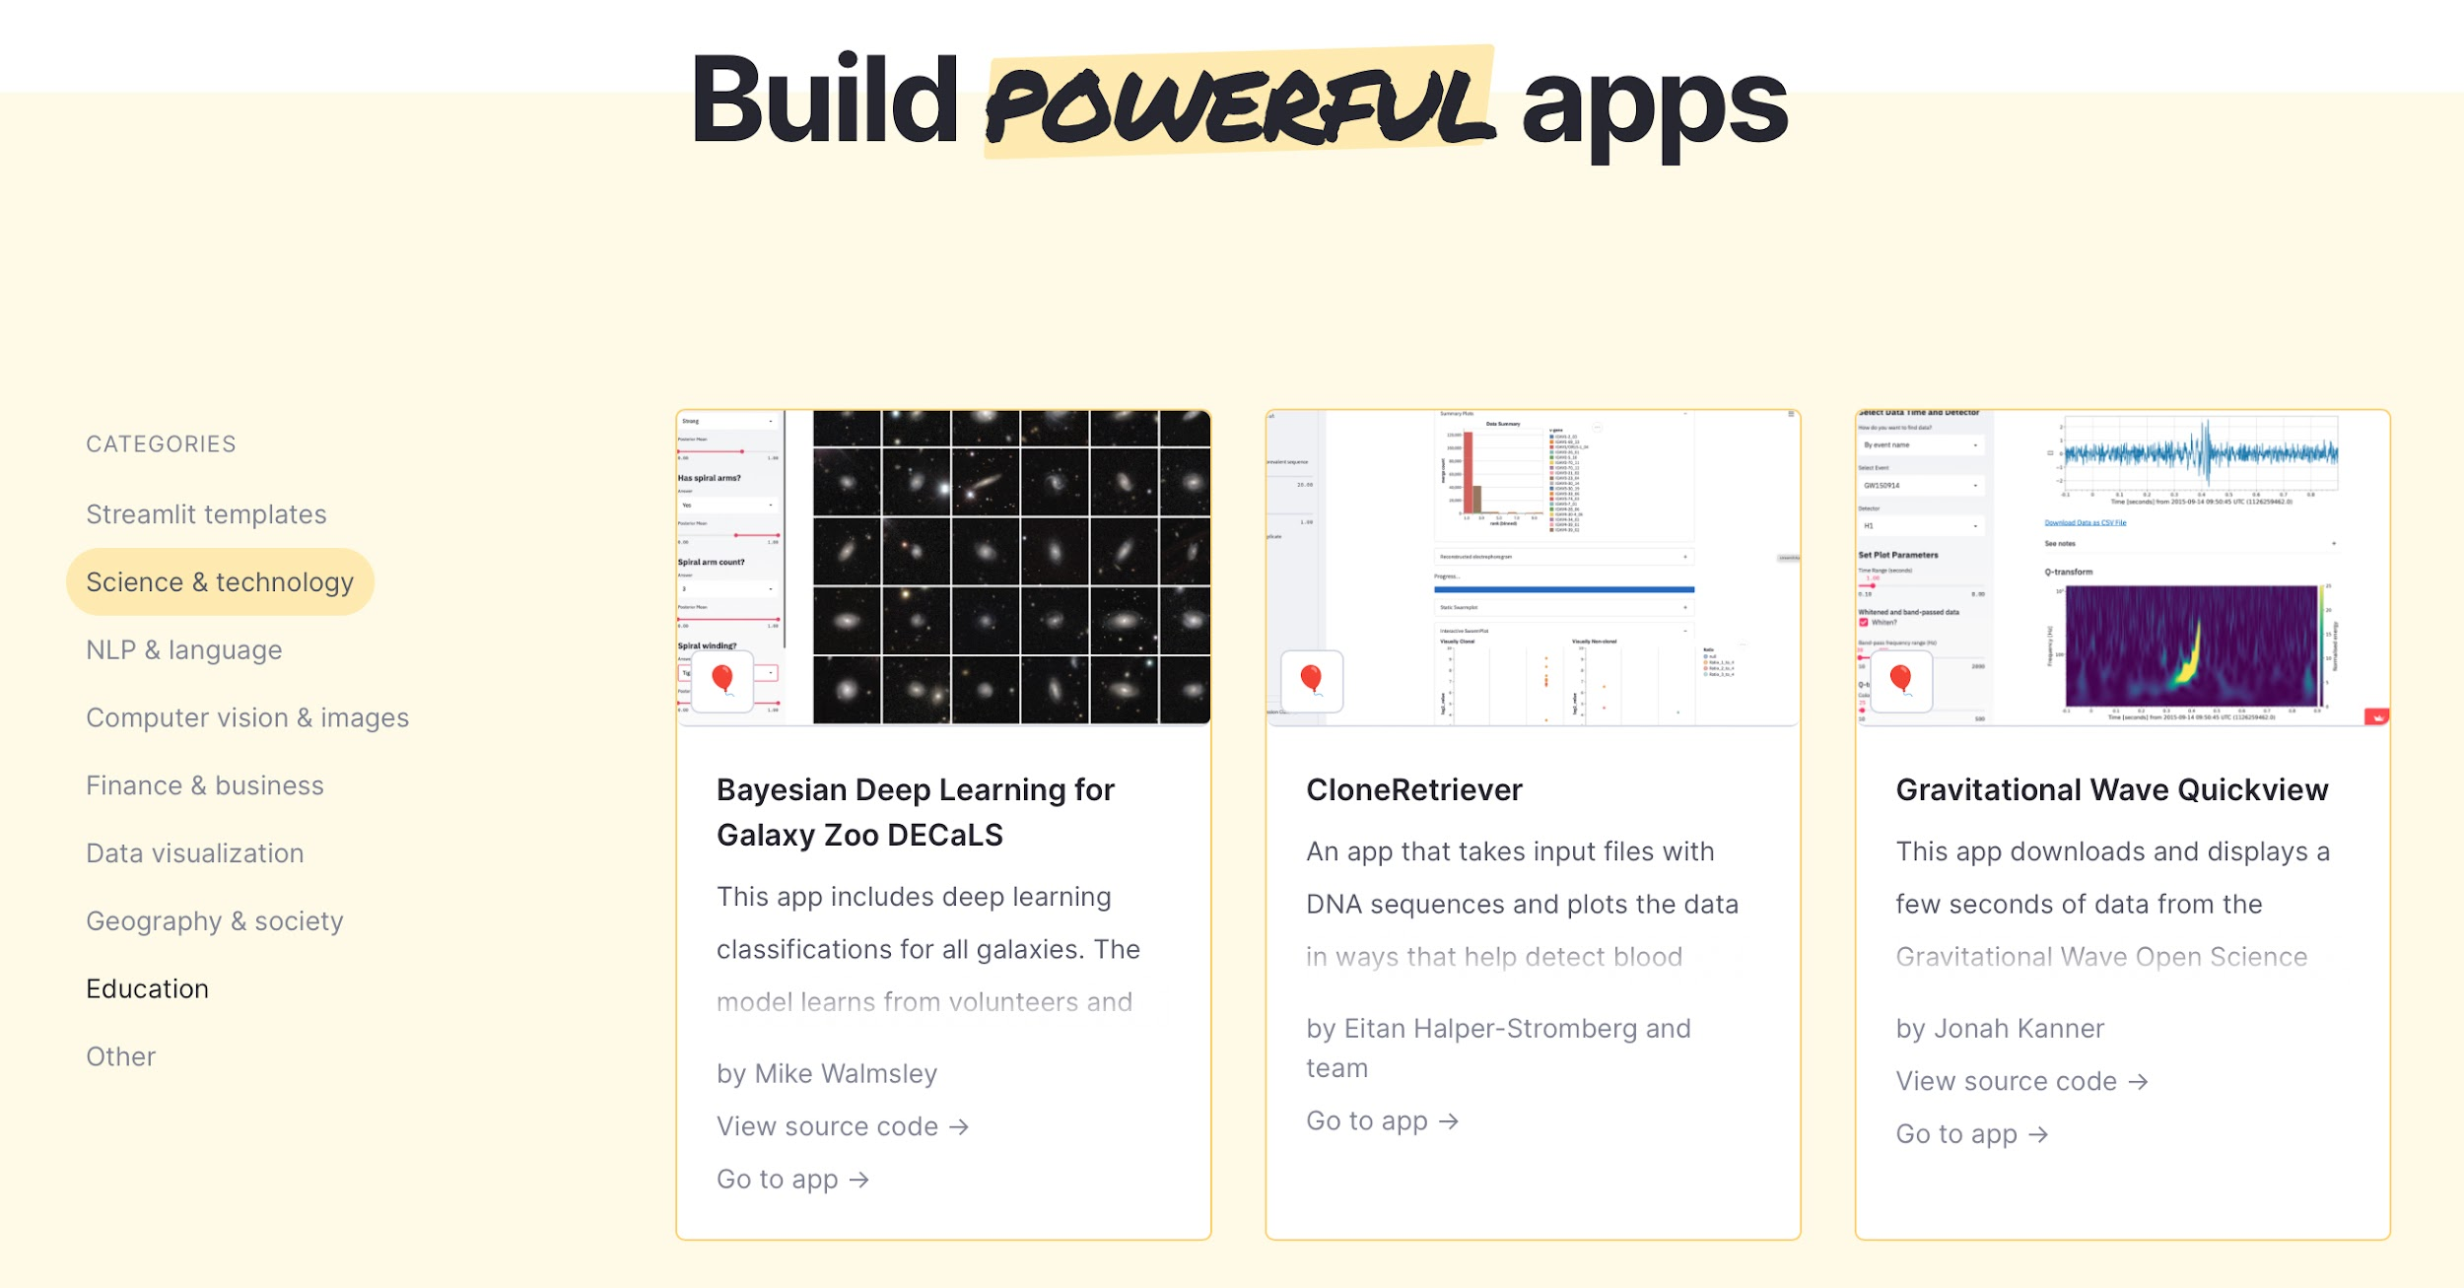
Gallery of Streamlit apps
If you’re looking to get inspired, you can check out the Gallery for examples of various Streamlit apps across several verticals

Slide 9
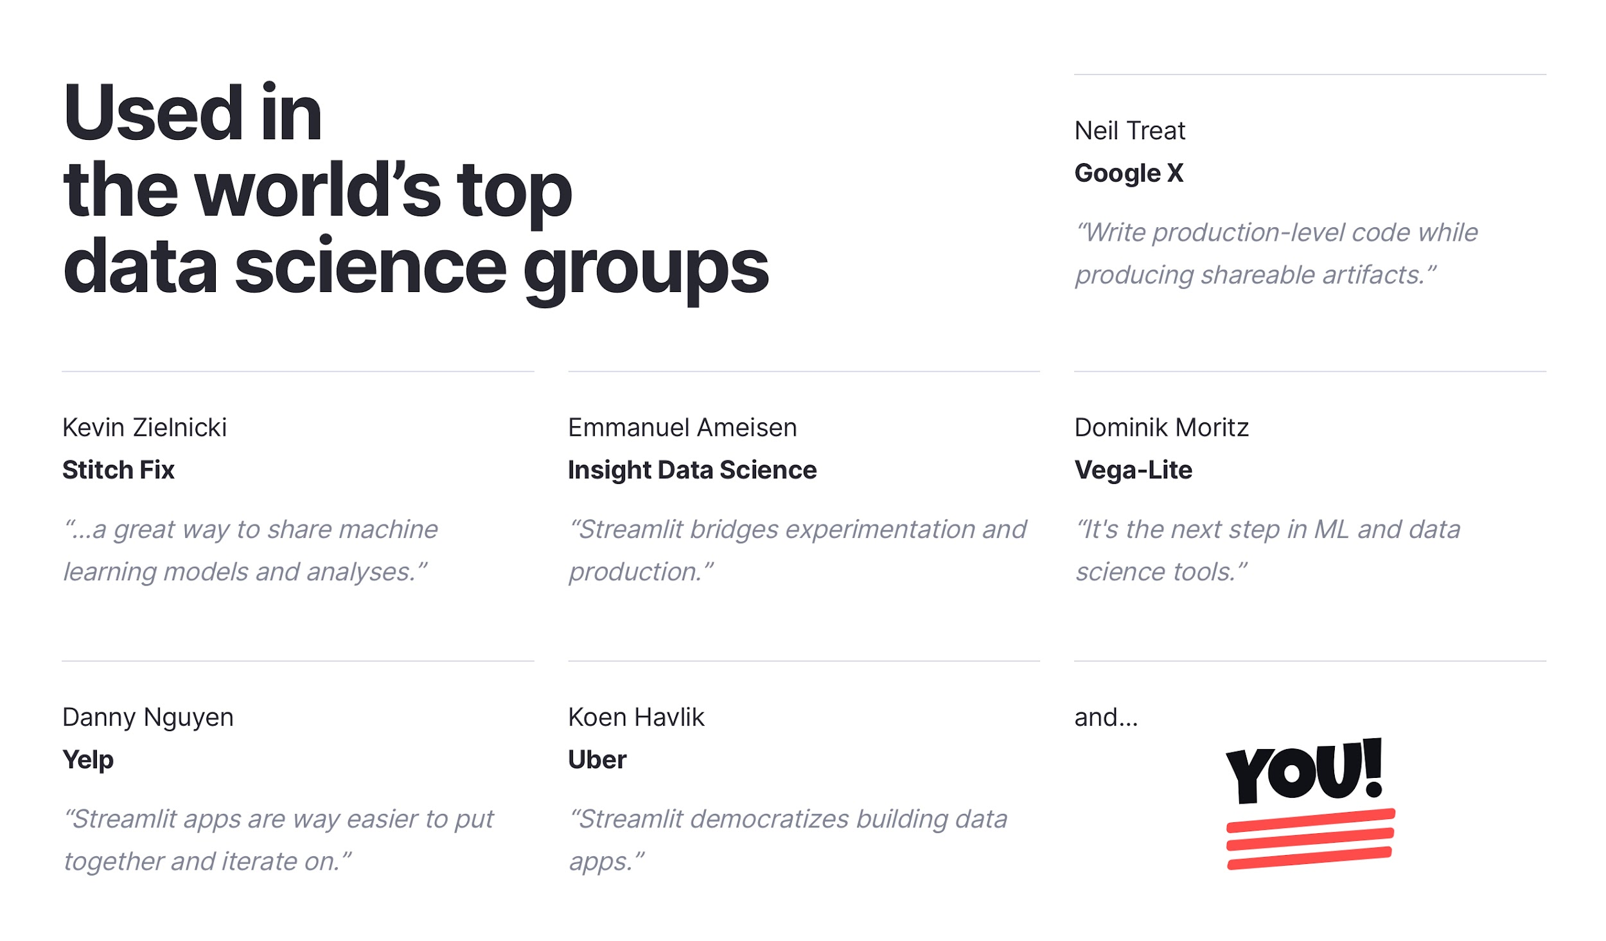
Streamlit for data science
Streamlit adds a visualization layer to scripts

Slide 10
3 simple principles of Streamlit
1. Embrace scripting
Build an app in a few lines of code with our magically simple API. Then see it automatically update as you iteratively save the source file.
2. Weave in interaction
Adding a widget is the same as declaring a variable. No need to write a backend, define routes, handle HTTP requests, connect a frontend, write HTML, CSS, JavaScript, ...
3. Deploy instantly
Effortlessly share, manage and deploy your apps, directly from Streamlit. All for free!

Slide 11

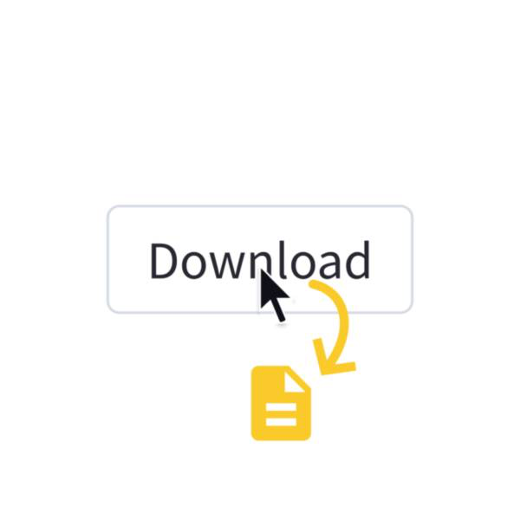
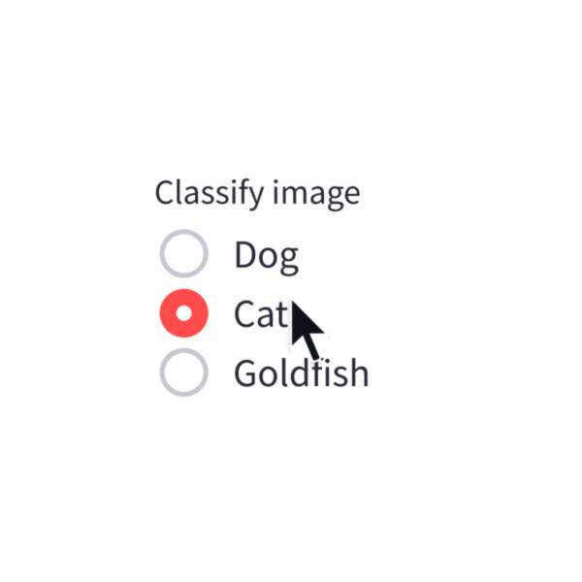
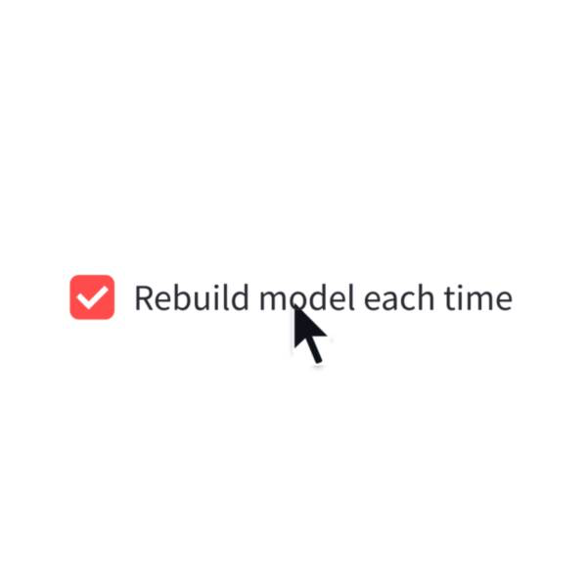
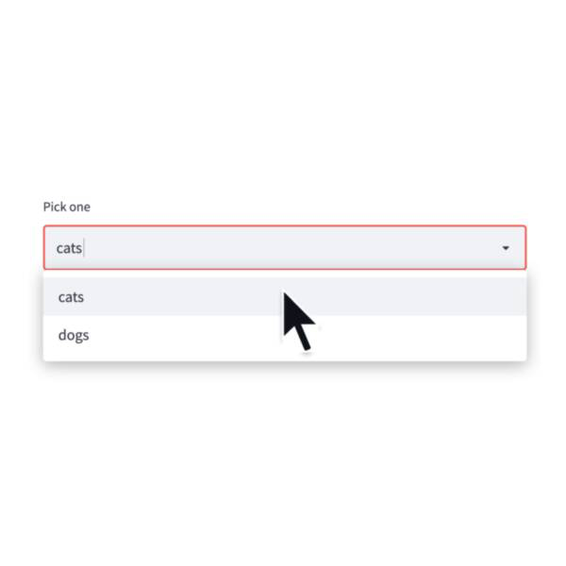
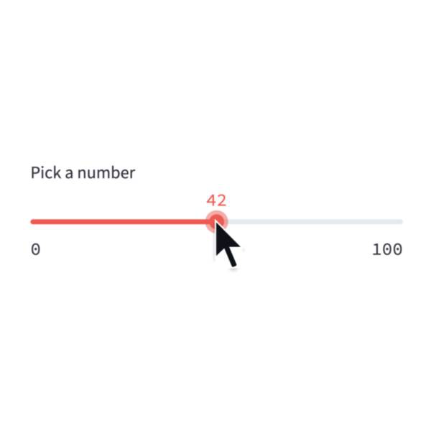
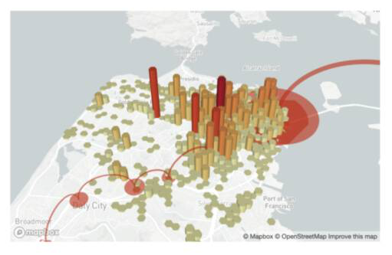
Coding a Streamlit app
A simple Streamlit app can start off as a single Python script file, e.g. app.py
Inside app file, you can import the Streamlit library via import streamlit as st and use any of the available Streamlit functions.
Input widgets
Output widgets

Slide 12
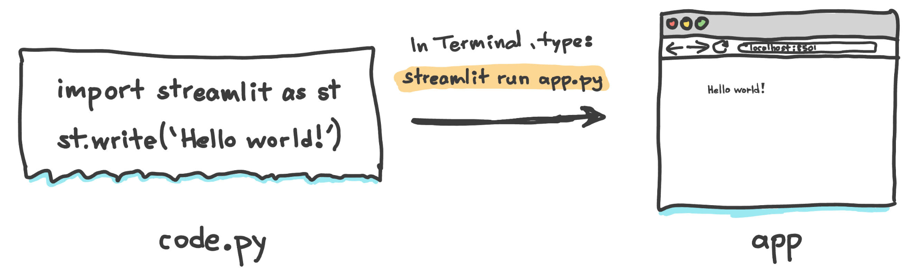
First Streamlit App
A minimal Streamlit app that prints Hello world!

Slide 13
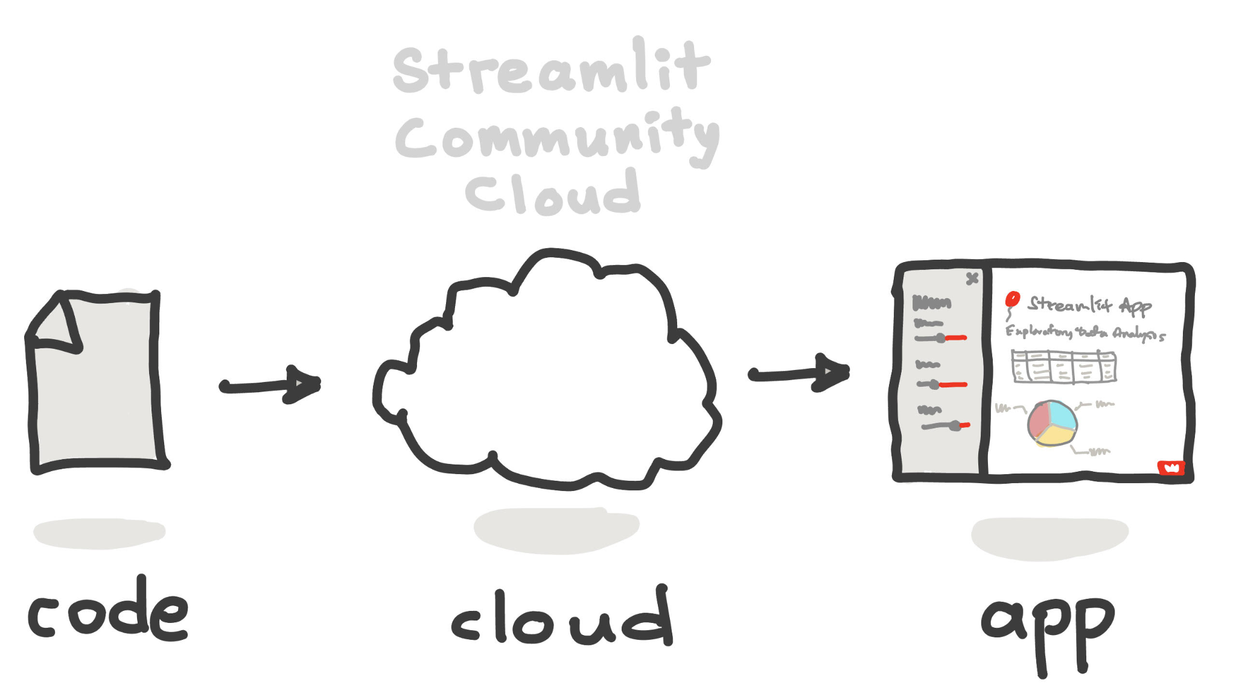
Deploy everywhere!
Streamlit apps can be deployed everywhere:
Locally
Cloud-host
Streamlit Community Cloud
HF Spaces
Self-host
AWS, Azure, GCP, etc.
In-browser
Stlite

Slide 14
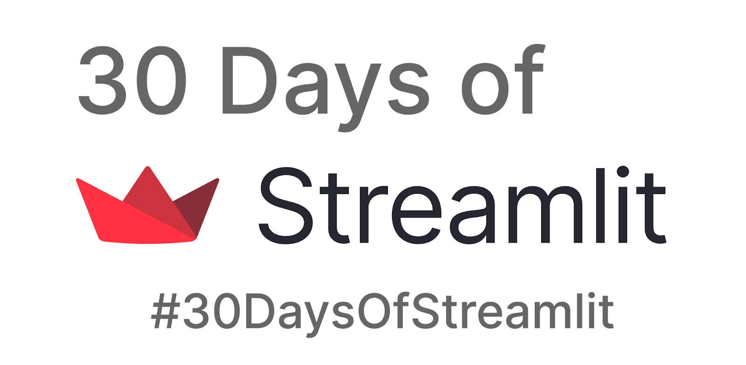
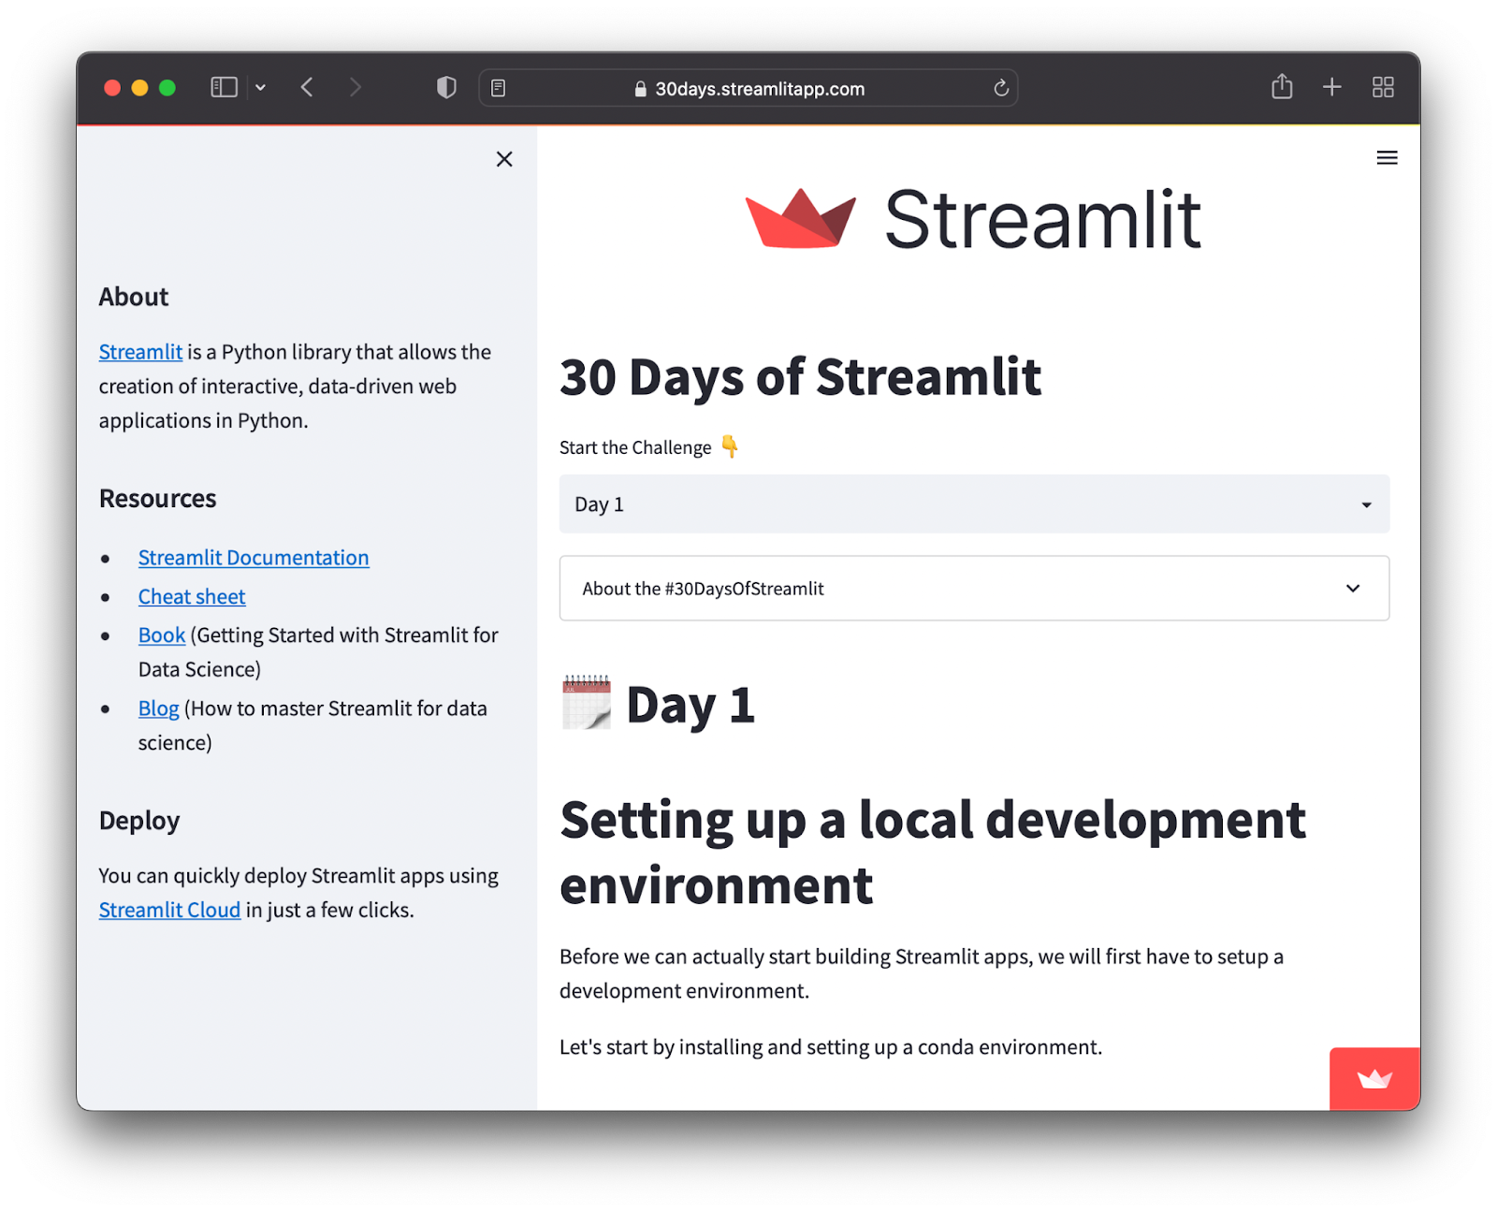
Learn with #30DaysOfStreamlit
What? #30DaysOfStreamlit is a social challenge for getting participants up to speed on building and deploying Streamlit apps.
How? The challenge draws its inspiration from several other learning challenges e.g. Ken Jee’s #66daysofdata, #100daysofcode, Kaggle’s #30DaysofML
When? The challenge started on April 1, 2022 where a new challenge was released daily
Where? Challenges were posted daily on Twitter and LinkedIn as well as the 30 Days app
Who? Anyone with a basic Python knowledge can participate.

Slide 15
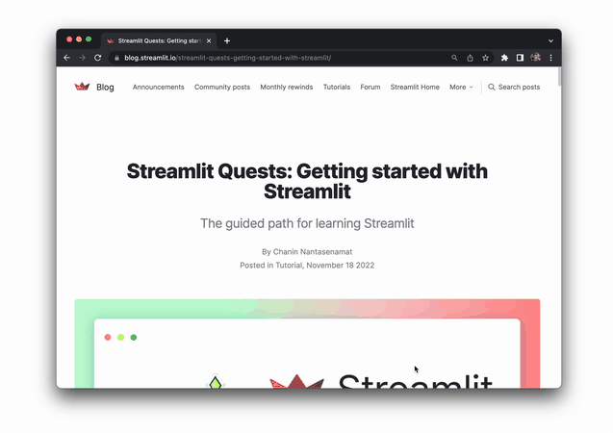
Streamlit Quests
A guided path for learning Streamlit that is conveniently summarized in the Streamlit Quests blog
Links to all essential Streamlit resources provided in the blog

